Slide 1
Database Systems
AICT005-4-1-Database Systems (version1)
Week 9: SQL (Part 1)

Slide 2
Topic & Structure of The Lesson
Basic commands and functions of SQL
SQL for data administration
SQL for data manipulation
SQL to query a database

Slide 3
Learning Outcomes
At the end of this topic, You should be able to
Write basic commands and functions of SQL(DDL & DML)

Slide 4
Key Terms You Must Be Able To Use
If you have mastered this topic, you should be able to use the following terms correctly in your assignments and exams:
Create
Insert
Update
Delete
Select

Slide 5
Introduction to SQL
SQL functions fit into two broad categories:
Data definition language
SQL includes commands to:
Create database objects, such as tables, indexes, and views
Define access rights to those database objects
Data manipulation language
Includes commands to insert, update, delete, and retrieve data within database tables

Slide 6
Introduction to SQL (continued)
SQL is relatively easy to learn
Basic command set has vocabulary of less than 100 words
Nonprocedural language
American National Standards Institute (ANSI) prescribes a standard SQL
Several SQL dialects exist

Slide 7
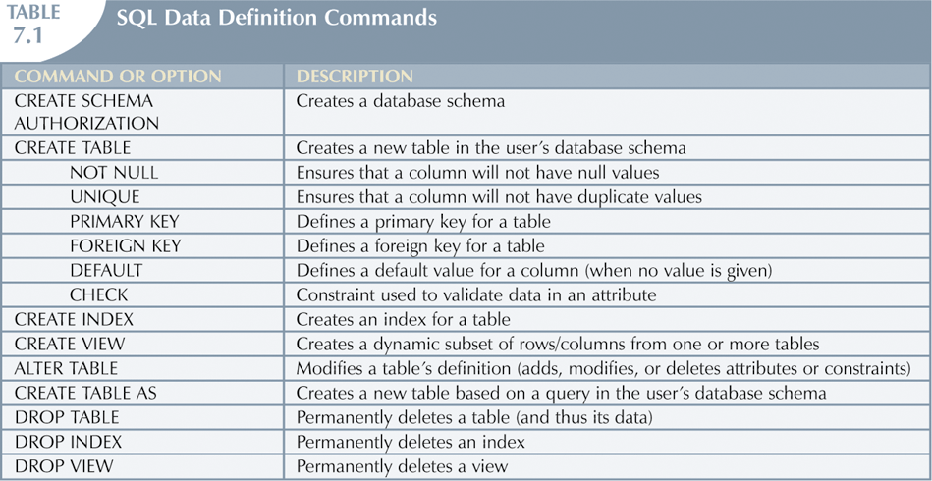
Introduction to SQL (continued)

Slide 8
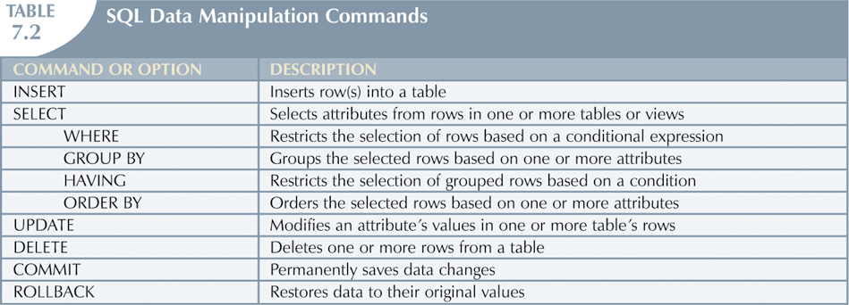
Introduction to SQL (continued)

Slide 9
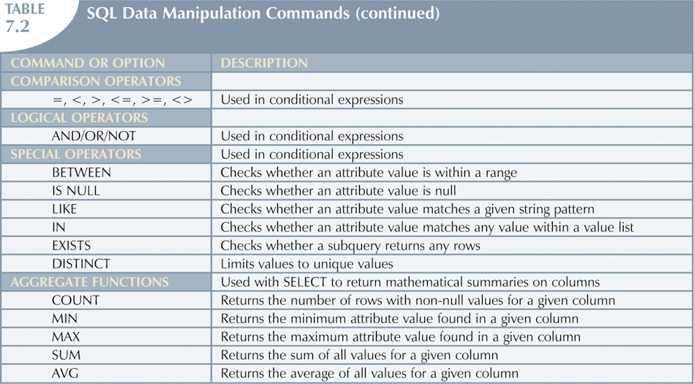
Introduction to SQL (continued)

Slide 10
Data Definition Commands
Examine simple database model and database tables that will form basis for many SQL examples
Understand data environment

Slide 11
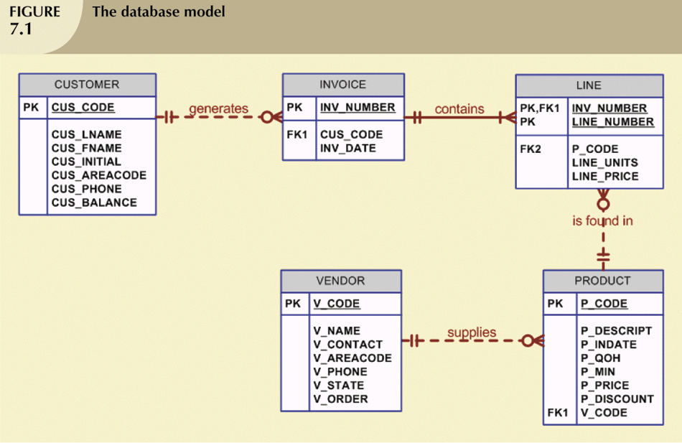
The Database Model

Slide 12
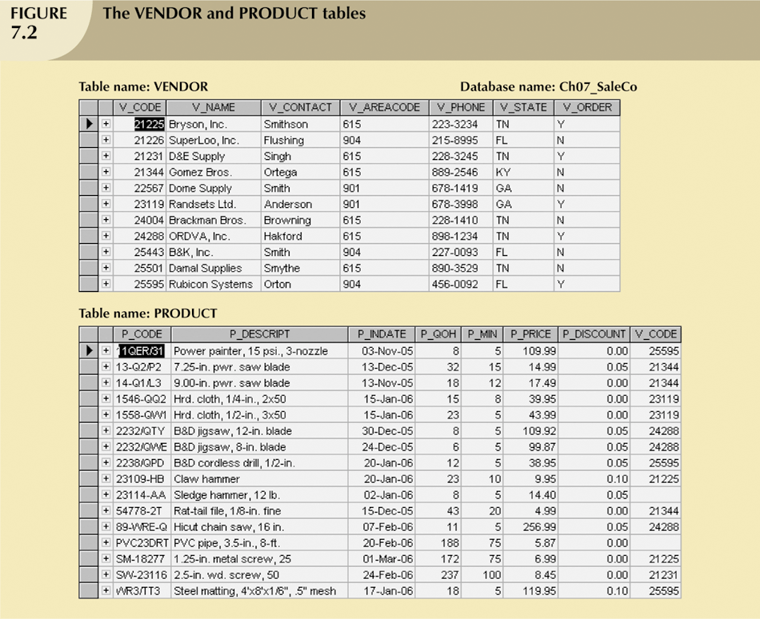
The Database Model (continued)

Slide 13
Creating the Database
Following two tasks must be completed:
Create database structure
Create tables that will hold end-user data
First task:
RDBMS creates physical files that will hold database
Tends to differ substantially from one RDBMS to another

Slide 14
The Database Schema
Authentication
Process through which DBMS verifies that only registered users are able to access database
Log on to RDBMS using user ID and password created by database administrator
Schema
Group of database objects—such as tables and indexes—that are related to each other

Slide 15
Data Types
Data type selection is usually dictated by nature of data and by intended use
Pay close attention to expected use of attributes for sorting and data retrieval purposes

Slide 16
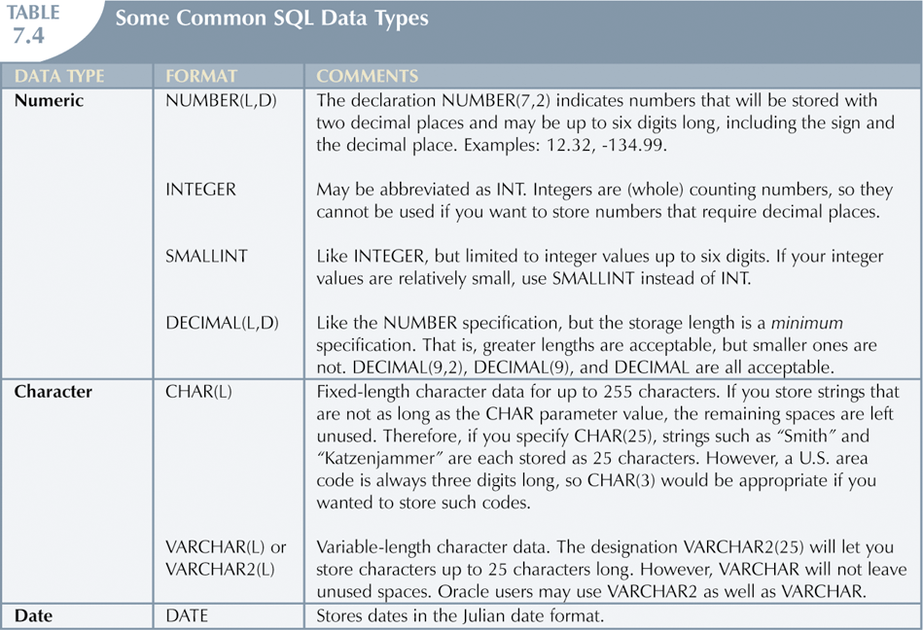
Data Types (continued)

Slide 17
Creating Table Structures
Use one line per column (attribute) definition
Use spaces to line up attribute characteristics and constraints
Table and attribute names are capitalized
NOT NULL specification
UNIQUE specification

Slide 18
Creating Table Structures (continued)
Primary key attributes contain both a NOT NULL and a UNIQUE specification
RDBMS will automatically enforce referential integrity for foreign keys
Command sequence ends with semicolon

Slide 19
SQL Constraints
NOT NULL constraint
Ensures that column does not accept nulls
UNIQUE constraint
Ensures that all values in column are unique
DEFAULT constraint
Assigns value to attribute when a new row is added to table
CHECK constraint
Validates data when attribute value is entered

Slide 20
Data Manipulation Commands
Adding table rows
Saving table changes
Listing table rows
Updating table rows
Restoring table contents
Deleting table rows
Inserting table rows with a select subquery

Slide 21
Adding Table Rows
INSERT
Used to enter data into table
Syntax:
INSERT INTO columnname VALUES (value1, value2, … , valuen);

Slide 22
Adding Table Rows (continued)
When entering values, notice that:
Row contents are entered between parentheses
Character and date values are entered between apostrophes
Numerical entries are not enclosed in apostrophes
Attribute entries are separated by commas
A value is required for each column
Use NULL for unknown values

Slide 23
Saving Table Changes
Changes made to table contents are not physically saved on disk until, one of the following occurs:
Database is closed
Program is closed
COMMIT command is used
Syntax:
COMMIT [WORK];
Will permanently save any changes made to any table in the database

Slide 24
Listing Table Rows
SELECT
Used to list contents of table
Syntax:
SELECT columnlist FROM tablename;
Columnlist represents one or more attributes, separated by commas
Asterisk can be used as wildcard character to list all attributes

Slide 25
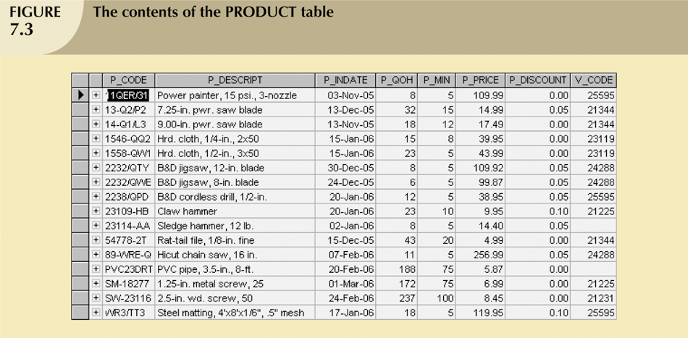
Listing Table Rows (continued)

Slide 26
Updating Table Rows
UPDATE
Modify data in a table
Syntax:
UPDATE tablename SET columnname = expression [, columname = expression] [WHERE conditionlist];
If more than one attribute is to be updated in row, separate corrections with commas

Slide 27
Restoring Table Contents
ROLLBACK
Used to restore database to its previous condition
Only applicable if COMMIT command has not been used to permanently store changes in database
Syntax:
ROLLBACK;
COMMIT and ROLLBACK only work with data manipulation commands that are used to add, modify, or delete table rows

Slide 28
Deleting Table Rows
DELETE
Deletes a table row
Syntax:
DELETE FROM tablename [WHERE conditionlist ];
WHERE condition is optional
If WHERE condition is not specified, all rows from specified table will be deleted

Slide 29
Inserting Table Rows with a Select Subquery
INSERT
Inserts multiple rows from another table (source)
Uses SELECT subquery
Query that is embedded (or nested) inside another query
Executed first
Syntax:
INSERT INTO tablename SELECT columnlist FROM tablename;

Slide 30
Selecting Rows with Conditional Restrictions
Select partial table contents by placing restrictions on rows to be included in output
Add conditional restrictions to SELECT statement, using WHERE clause
Syntax:
SELECT columnlist FROM tablelist [ WHERE conditionlist ] ;

Slide 31
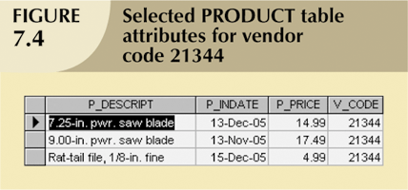
Selecting Rows with Conditional Restrictions (continued)

Slide 32
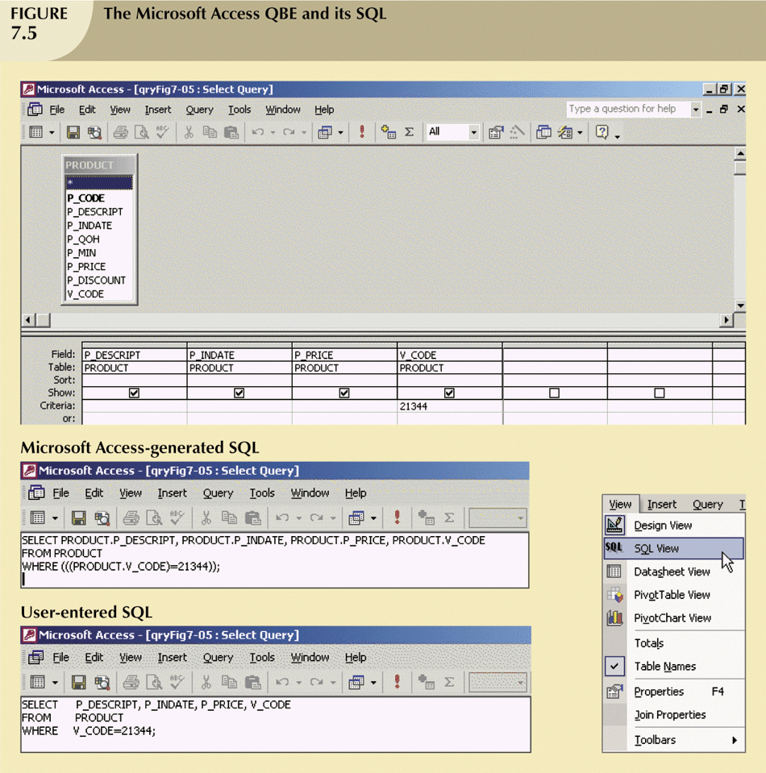
Selecting Rows with Conditional Restrictions (continued)

Slide 33
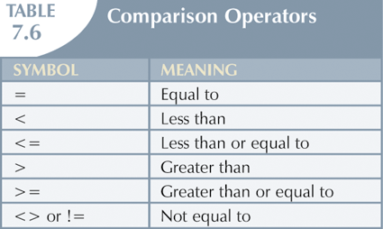
Selecting Rows with Conditional Restrictions (continued)

Slide 34
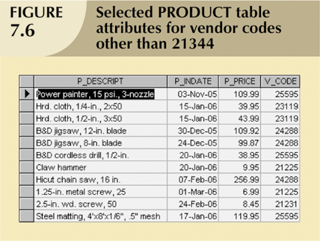
Selecting Rows with Conditional Restrictions (continued)

Slide 35
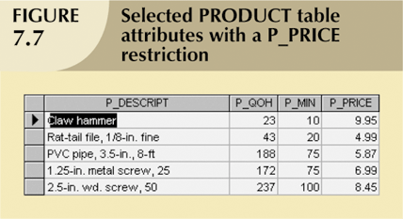
Selecting Rows with Conditional Restrictions (continued)

Slide 36
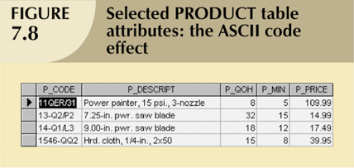
Selecting Rows with Conditional Restrictions (continued)

Slide 37
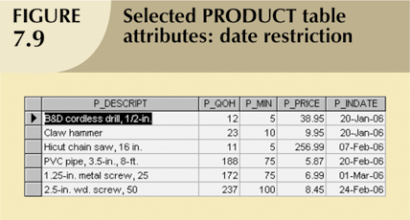
Selecting Rows with Conditional Restrictions (continued)

Slide 38
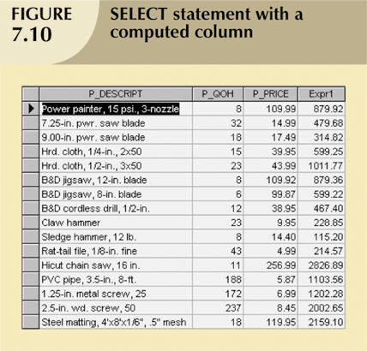
Selecting Rows with Conditional Restrictions (continued)

Slide 39
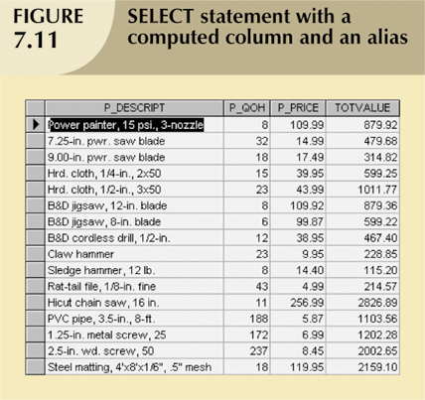
Selecting Rows with Conditional Restrictions (continued)

Slide 40
Arithmetic Operators: The Rule of Precedence
Perform operations within parentheses
Perform power operations
Perform multiplications and divisions
Perform additions and subtractions

Slide 41
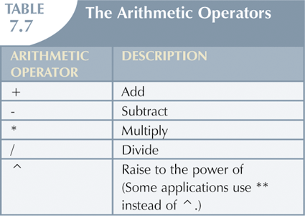
Arithmetic Operators: The Rule of Precedence (continued)

Slide 42
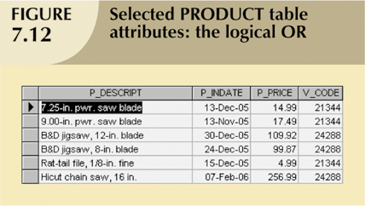
Logical Operators: AND, OR, and NOT

Slide 43
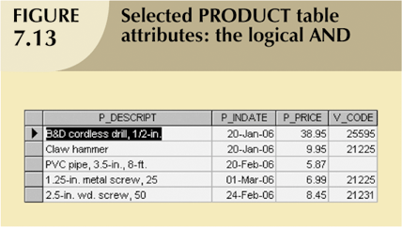
Logical Operators: AND, OR, and NOT (continued)

Slide 44
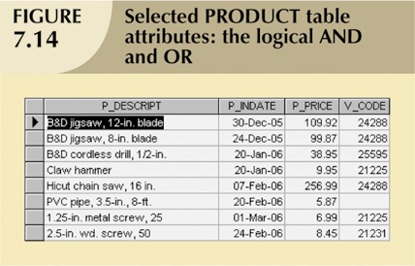
Logical Operators: AND, OR, and NOT (continued)

Slide 45
Special Operators
BETWEEN
Used to check whether attribute value is within a range
IS NULL
Used to check whether attribute value is null
LIKE
Used to check whether attribute value matches given string pattern

Slide 46
Special Operators (continued)
IN
Used to check whether attribute value matches any value within a value list
EXISTS
Used to check if subquery returns any rows

Slide 47
Quick Review Question
Describe the difference between DDL & DML

Slide 48
Summary of Main Teaching Points
SQL functions fit into two broad categories:
Data definition language
SQL includes commands to:
Create database objects, such as tables, indexes, and views
Define access rights to those database objects
Data manipulation language
Includes commands to insert, update, delete, and retrieve data within database tables

Slide 49
Summary of Main Teaching Points
DML commands allow you to add, modify, and delete rows from tables
The basic DML commands are SELECT, INSERT, UPDATE, DELETE, COMMIT, and ROLLBACK
INSERT command is used to add new rows to tables
SELECT statement is main data retrieval command in SQL

Slide 50
Question and Answer Session
Q & A

Slide 51
What we will cover next
Advanced SQL
Aggregate functions
JOINS

